Slide 1



Seismometer Position Optimization for Newtonian Noise Mitigation in the Einstein Telescope
Patrick Schillings and Johannes Erdmann
III. Physikalisches Institut A, RWTH Aachen University
07.03.2024 – DPG Karlsruhe (T 95.8)

Slide 2
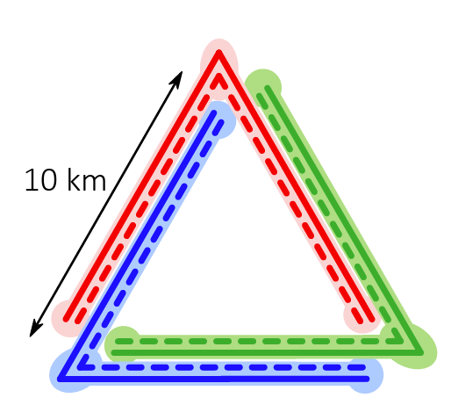
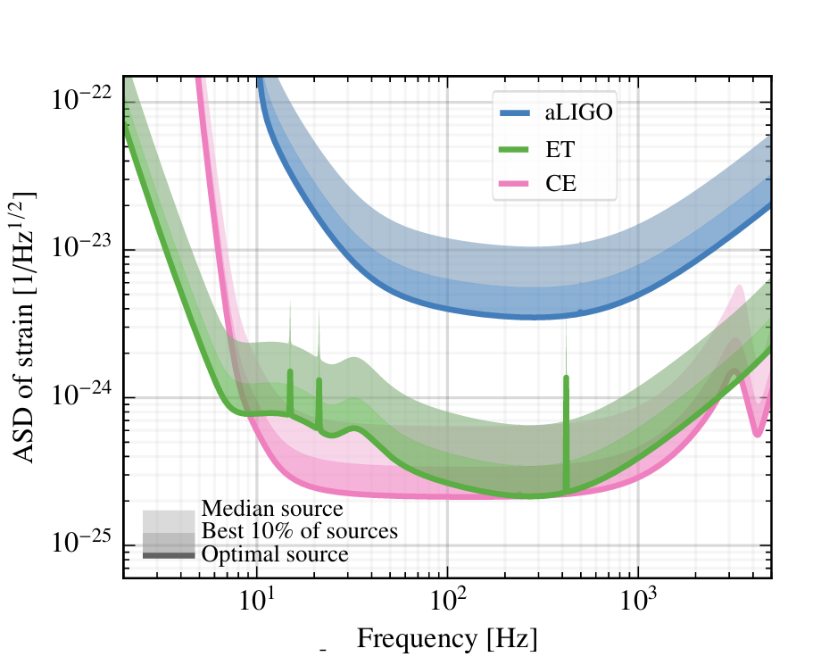
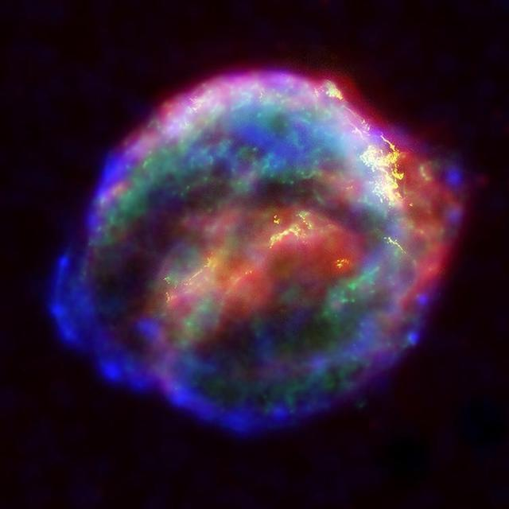
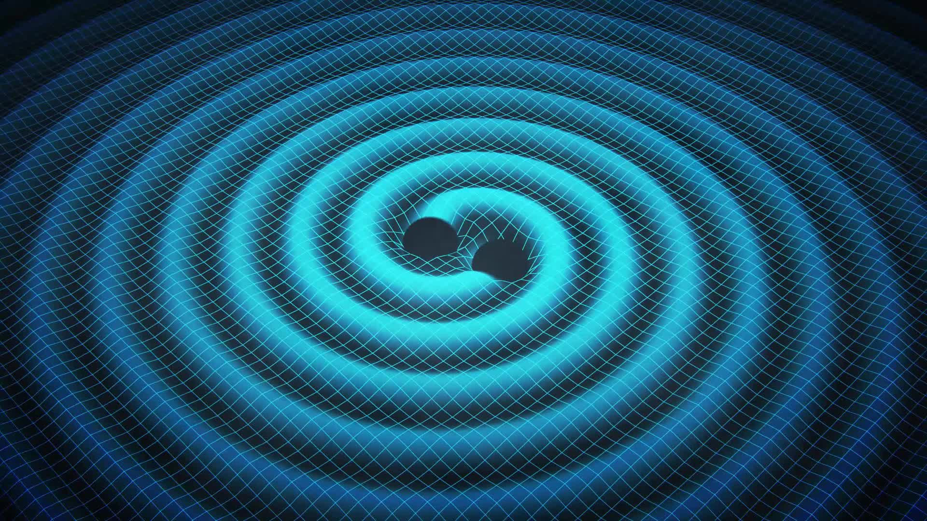
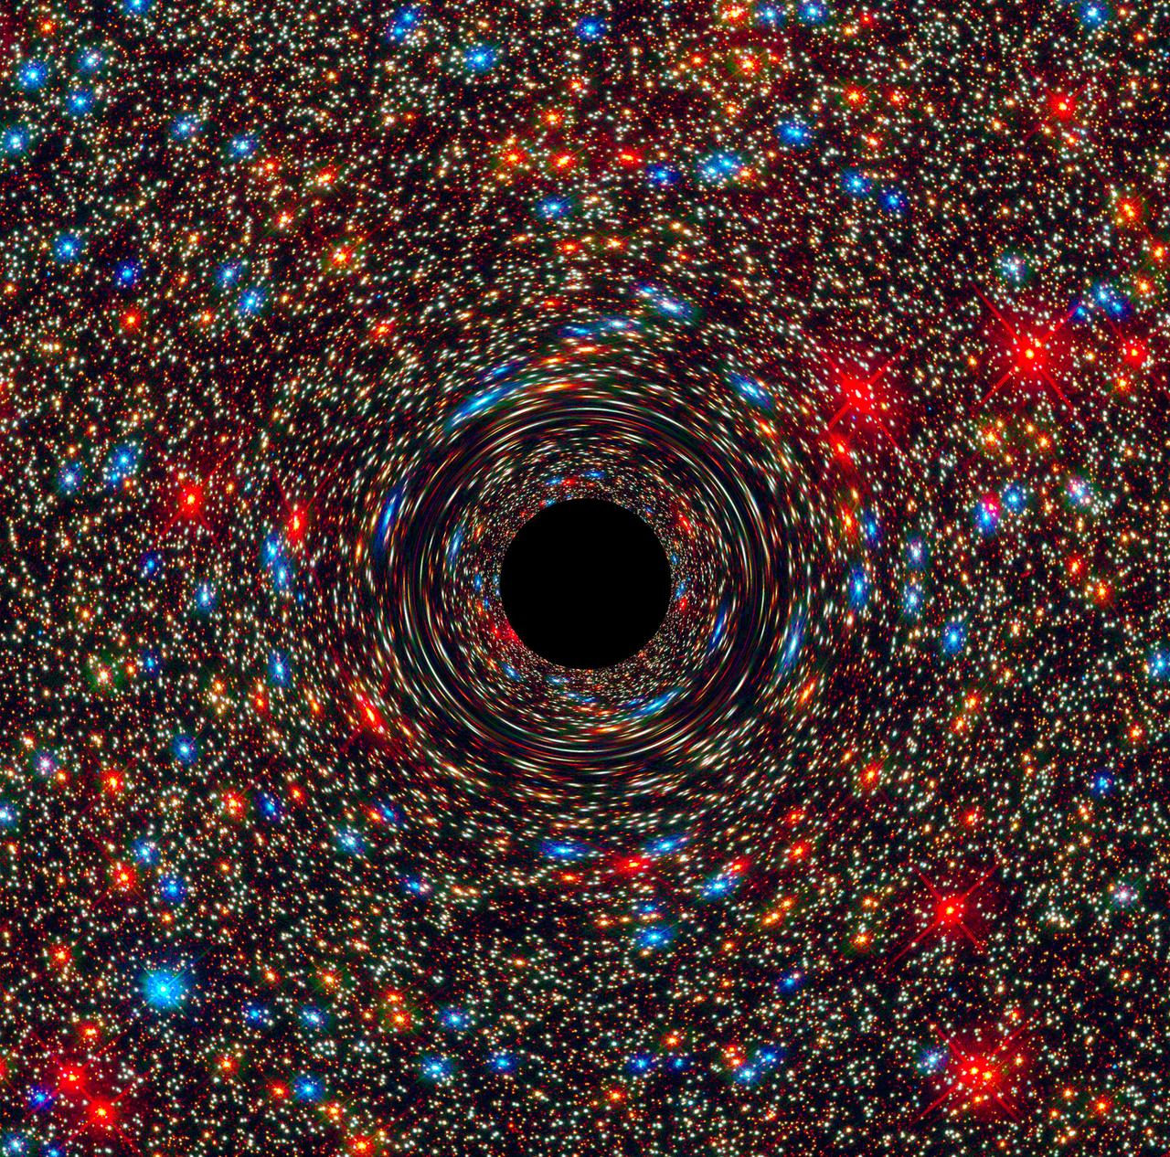
The Einstein Telescope
ET design report update (2020)
ET design report update (2020)
Swinburne Astronomy Productions
NASA
NASA

Slide 3
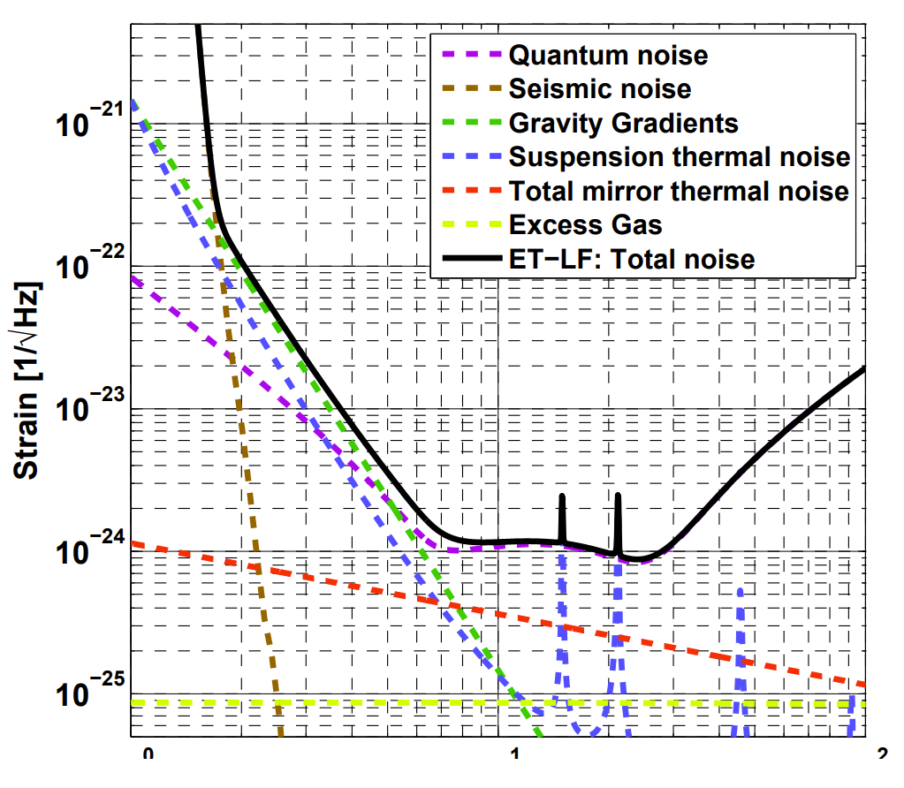
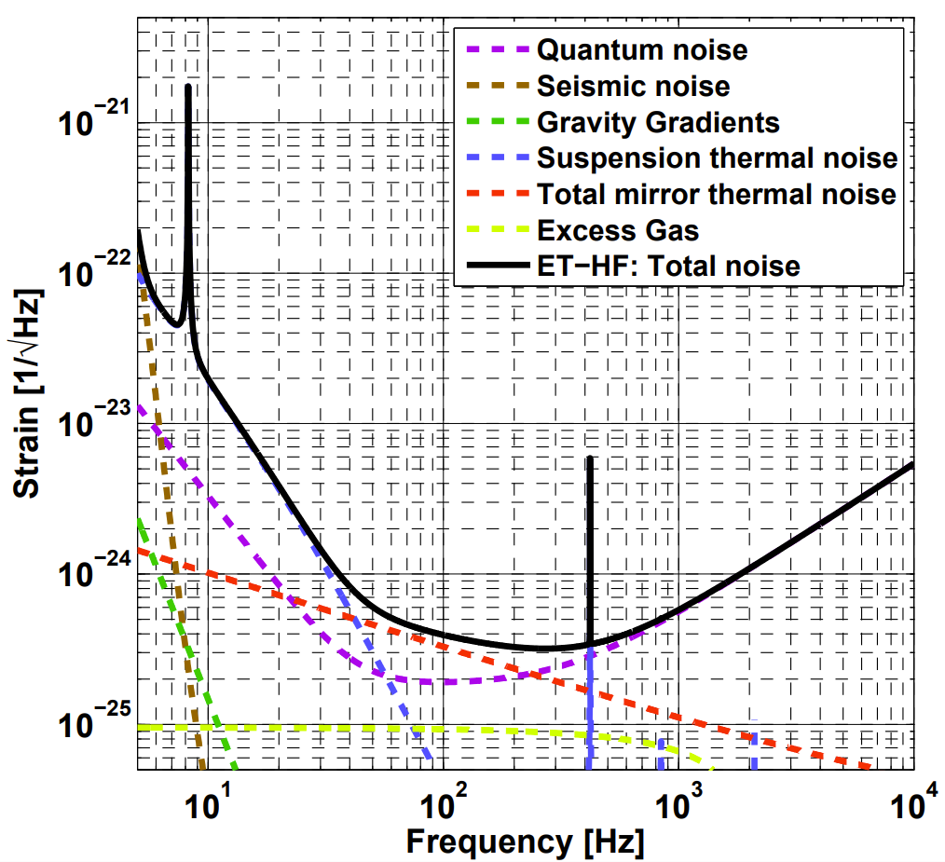
Einstein telescope‘s limiting noise curve
Hild et al., arXiv:1012.0908

Slide 4
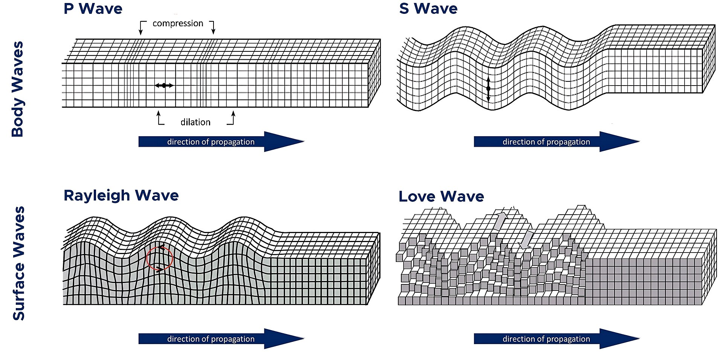
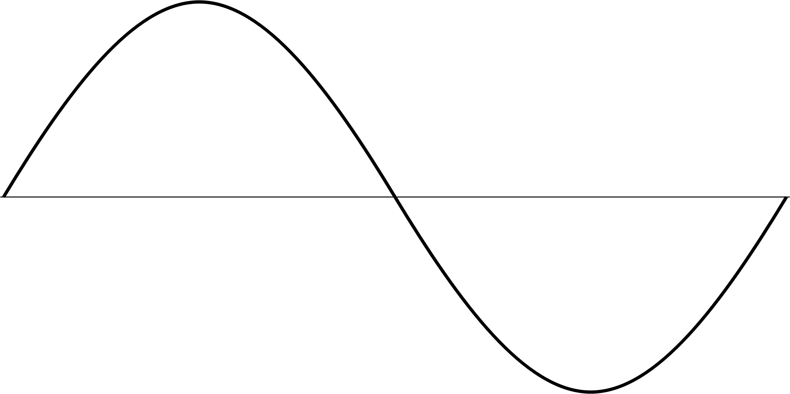
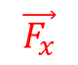
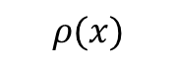
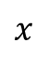
Newtonian Noise
$$\vec{F_{x}}$$
$$ρ(x)$$
B.A. Bolt, Textbook (1982)
$$x$$
Density fluctuations in the Earth couple gravitationally to the ET mirror
Cannot be shielded: Must be predicted and subtracted
Boreholes for seismometers are expensive
→Optimize seismometer positions

Slide 5
